Slide 1
User Input
ICS2 – Introduction to Programming

Slide 2
Getting Input from the Keyboard
Java provides classes and methods to enable user to input a stream of data from the keyboard
Basic input methods are contained in the classes:
BufferedReader
Scanner
JOptionPane

Slide 3
BufferedReader Class
Found in java.io package
Steps in using BufferedReader to get user input:
Add import java.io.*; on top of the code
Add the statement BufferedReader dataIn = new BufferedReader(new InputStreamReader(System.in)); in the main block.
Declare a temporary String variable to hold the input then invoke the readLine() method to get the input from the keyboard. The readLine() method must be inside a try-catch block.

Slide 4
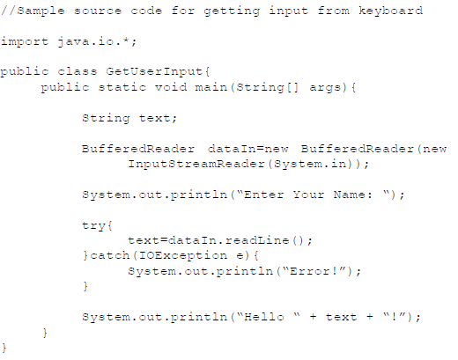

Slide 5
Getting Input of Other Data Types
The BufferedReader and InputStreamReader together with readLine() will get a String input only
When the input is another data type, it needs to be parsed (converted)

Slide 6
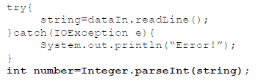
Converting input to integer
Immediately after the try-catch block, include the statement Integer.parseInt() and assign it to an integer value

Slide 7
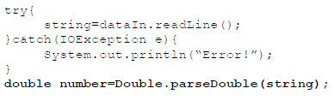
Converting input to double
Immediately after the try-catch block, include the statement Integer.parseDouble() and assign it to a double value

Slide 8
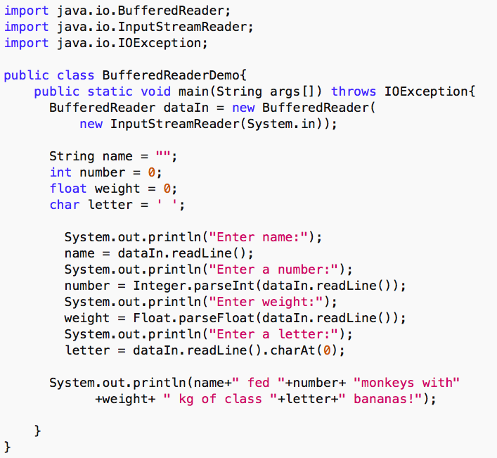

Slide 9
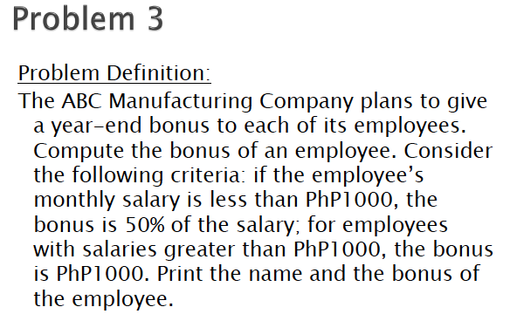

Slide 10
Scanner Class
Found in java.util package
Steps in using the Scanner class:
Include the statement import java.util.*; on top of the class
Add the Scanner dataIn = new Scanner(System.in); in the main block.
Use the nextLine() method for String inputs

Slide 11
import java.util.*;
public class UserInput{
public static void main(String args[]){
Scanner dataIn = new Scanner(System.in);
System.out.print(“What is your name? “);
String name = dataIn.nextLine();
System.out.print(“\nHello “ + name);
}
}

Slide 12
Getting Input of Other Data Types
Scanner class supports getting primitive data types by using the appropriate method:
Read a byte - nextByte()
Read a short - nextShort()
Read an int - nextInt()
Read a long - nextLong()
Read a float - nextFloat()
Read a double - nextDouble()
Read a boolean - nextBoolean()

Slide 13
JoptionPane Class
Found in javax.swing package
Steps in using the JOptionPane class:
Include the statement import javax.swing`.*; on top of the class
Add the JOptionPane.showInputDialog(<String>); and assign it to a String variable in the main block
Note: Like BufferedReader class, JOptionPane class only accepts String input

Slide 14
Getting Input of Other Data Types
The JOptionPane class will get a String input only
When the input is another data type, it needs to be parsed (converted)
parseInt
parseDouble
parseFloat
parseByte

Slide 15
import javax.swing.*;
public class UserInput{
public static void main(String[] args){
String input;
input = JOptionPane.showInputDialog
(“Enter Name:”);
System.out.println(“Hello: “ + name);
}
}

